Slide 1
Challenges and Opportunities in Small Hydro Development & Discussion on Innovative Development & Investment/Financing Model
Er. Surya Prasad Adhikari
Executive Chairman
Barahi Hydropower Public Limited

Slide 2
Contents
1. Background
1.1 License Status
1.2 Investment Status
1.3 Baseline of IPPs Operating Projects before COVID
Impact of COVID-19 pandemic.
2.1 Sales/Generation; Income ; Safety of Project Structures
4. Recommendations for immediate relief
5. Way Forward:
4.1 Development Model
4.2 Financial Model

Slide 3
1.1 License Status (upto 5 MW)
Survey License Applied
Below 1 MW 1 project/0.67 MW
Upto 3 MW 1 project/0.67 MW
Upto 5 MW 3 projects / 12 MW
Survey License Received
Below 1 MW 15 Projects / 10.74 MW
Above 1 to 3 MW 7 Projects / 16.35 MW
Above 1 to 5 MW 23 Projects / 83.939 MW
Generation License Applied
Below 1 MW 1 project / 0.485 MW
Upto 3 MW 1 project / 0.485 MW
Upto 5 MW 5 projects /18.775 MW
Generation License Received
Below 1 MW 25 projects / 19.63 MW
Upto 3 MW 42 Projects /59.69 MW
Upto 5 MW 77 projects /218.533 MW
Operating Projects
- Below 1 MW
15 /11.24 MW ;
- Above 1-5 MW
41 /143.59 MW
Total 155.83 MW

Slide 4
1.2 Investment Status
Total Small Hydro Capacity upto 5 MW identified are 211 having installed capacity 516 MW estimates the production of 2500 GWh that replaces 85% Carbon emission compared to other dirty sources annually and will contribute 2000 Cr. Rupees in rural economy
Investment in Survey and Design
NRs. 158 Cr. for 361.287 MW
Investment in Production
NRs. 3428 Cr. for 155.83 MW
License Cancelled
Number of Projects 87
Total Capacity 296.578 MW
Approximately 200 MW can be designed as PROR

Slide 5
1.3 Pre-COVID-19 Baseline of IPP’s Operating Projects (Based on data as of Ashadh 2077)
Out of 66 IPP’s Projects (172.5 MW)
Four Hydropower Companies received 35 days loan clearance notice and in the process of blacklisting the major promoters.
30 projects are sick and 21 projects are in poor fiscal status.
30 Projects having 112 MW capacity are not able to regularize their interest and principle from their income.
The average Production per MW is 3.9 GWh per anum.
Average Annual Sales Loss due to Outage >18 % of total Income (only in 33 and 11 kV lines)
Hydrological Flow Loss 7.5% to 25% (in Q₄₀ Design –natural and Manmade)
Average annual AD Penalty upto 14 % of total Income
Average Sales is 35%-86% of Contract Energy.
The Annual loss ranges from 2-12 Cr. for projects <10 MW.
The un-served interest and principle of sick projects(30 Projects) is approximately 45 Cr. as of Ashwin 2076. Likely to increase to 100 Crores as of Chaitra 2076

Slide 6
Pre-COVID-19: Problem Statement
2072 Earthquake, Blockade /Fuel Crisis and JANAUDDHA / 2063 People’s Movement /TERAI ANDOLAN and series of Nepal BANDHAs (impacted 15-25 % in Direct Cost and 25-35% in overall Fiscal Status)
Power Evacuation Problems (1990s Transmission System)
Unhealthy Transmission Lines (33 kV and 11 kV)
Poor Hydrology
No sufficient data for Hydrological study
Irrigation and Drinking water system constructed upstream of the projects
NRs 50 Lakhs per MW subsidy not disbursed (@)&! sf] ah]6 efif0f)
Continuation of AD Penalty -/fli6«o pmhf{ ;+s6 lgjf/0f tyf ljB't ljsf; bzs ;DaGwL cjwf/0f kq, @)&@ sf] bkmf ^% cg';f/ !) d]ufjf6 eGbf ;fgf cfof]hgfx?df Availability Declaration (AD) df xhf{gf gnfUg] .
Lack of Corporate Governance in IPPs and
No Regulatory Authority to monitor the governance and transparency (PPA, PDA, subsidies, electricity tariff, promotions etc..)

Slide 7
Performance of IPP’s Projects under 5 MW (12% int rate, 60% sales returns and PPA rate 4.25 and 4/7)
Average Project cost / MW before 2071-2063 is < 17 Cr. (Min 13 Cr. And Max ~19 Cr.)
Average Project cost / MW after 2069-2075 is < 21 Cr. (Min ~19 Cr. And Max ~26 Cr.)
Hydro is loss making business
At present, most of the project’s Net worth per share is less than Rs. 50 few of them have negative value
L-Curve Prolonged

Slide 8
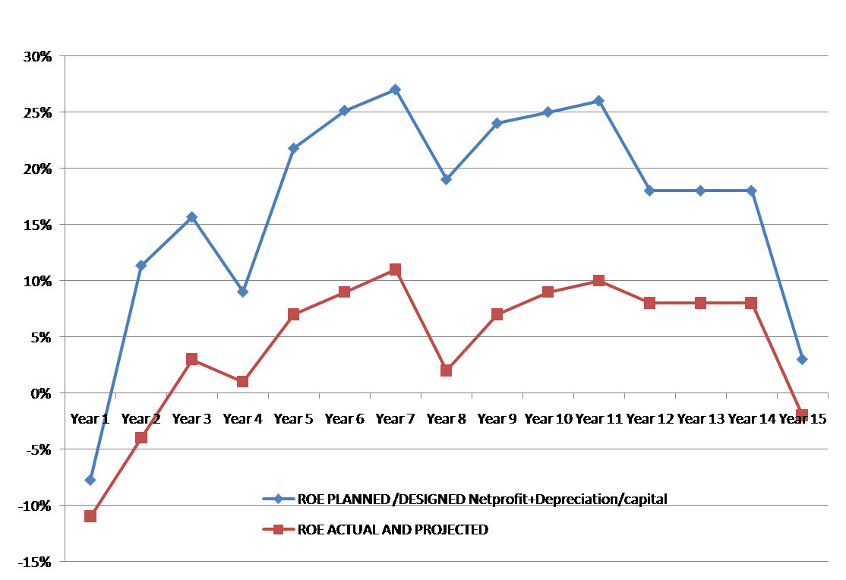
Performance of IPP’s Projects (5-10 MW) (12% int rate, 60% sales returns and PPA rate 4.8/8.40)
Average Project cost / MW before 2071-2063 is < 17 Cr. (Min 13 Cr. And Max ~19 Cr.)
Average Project cost / MW after 2069-2075 is < 21 Cr. (Min ~19 Cr. And Max ~26 Cr.)
Hydro is loss making business
At present, most of the project’s Net worth per share is less than Rs. 50 few of them have negative value
L Curve starts from 16th Year of Operation
Income drops in every 4th year due to replacement of major maintenance and equipment replacement.

Slide 9
Impact of COVID-19 Lock Down
Personnel Hygiene
Not every projects has safe and hygienic working environment
Difficulty to supply/maintain foodstuffs and medical facilities
Major Operation & Maintenance of Project Structures normally planned during Baishakh and Jestha
Pre-Monsoon started
Unexpected loss of sales and damage of project structures during monsoon.
Import of Spare parts and Foreign Expert’s Visit
Shutdown of two projects due to O&M problem (Totaling ~8 MW)
Generation loss of approximately 19 MW reported since Chaitra & will increase if the lockdown period increases.
Cash Flow (Force Majeure Clause activated by purchasing party)
Small Projects are vulnerable and roughly estimates 10-15% loss in Generation /Sales in FY 2076/077.

Slide 10
Recommendations: Immediate Action
35 days notice issued/published for loan repayment to be withdrawn.
Provide Interest subsidy of 5 % for Sick projects for the remaining loan tenure.
Posted rate for all projects less than 25 MW for the period a until scientific tariff structure is studied and issued by ERC ( Among the Sick project, only 11 projects total capacity 24.89 MW are not getting posted rate)
Disburse the Subsidy NRs. 50 Lakhs/MW ( g]kfn ;/sf/sf] ah]6 aStAo @)&!÷)&@ df 3f]if0ff eP adf]lhd ) for the project commissioned within 2074/075. Similarly an annual disbursement plan to develop for other projects too.
Resolve the issue of Penalty imposed on AD and Late COD by NEA specifically for <10 MW Projects
Resolve Un-dispatched energy cost due to Transmission Outage and Transmission Bottlenecking.
Provide Compensation to the projects suffering from alternative arrangement of Power Evacuation that limits their production.

Slide 11
“We will make electricity so cheap that only the rich will burn candles.”
― Thomas A. Edison
is it possible in Nepal??
Lets say “Small is Beautiful”
Don’t Say;
Small developers are “FOOL”

Slide 12
Demand versus Supply and DSM
Planned/Designed
Demand
River Flow
Surplus Who lose??
PU Values
Deficit Who lose??
Months

Slide 13
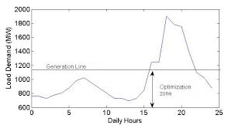
Demand and Supply versus Investment Economics
Deficit Who lose??
Surplus Who lose??

Slide 14
Recommendations:
Establish “Rescue Fund” of 200 Cr. with the support from DONORs/GON/IPPs for immediate relief package for sick projects
Formation of Team to study the risks associated on Electricity Generations from IPPs and Public Sector (Donors, IPPs, ERC, Bankers, NEA, DoED etc.)
Formation of Study Team to study on Development and Financial Modality of Hydropower for its Sustainable development

Slide 15
4.1 Development Model
Principle
Local Development (Water, Women and Watersheds) for Local Energy Security
Capacity Building and Employment Generation
Enterprise Development ( Operation and Maintenance Workshop and Agro-based Industries)
Public Participation
Corporate Governance / Autonomous Management
Public Company (Before or After??)
Major Promoters (51%)
Local Government share (19%)
General Public Share (30%)
Two Part Tariff (Installed capacity and Energy Production)
EPC/EPCF/Item rates and Design Built ….Contract Model ??
Project will be operated by a Public Company forever
The base year Project Cost NRs. 5 Cr. /GWh (Contract Energy) plus 3 year(Construction Period) annual escalation on project cost as per NRB.

Slide 16
4.2 Investment/Financing Model
Project Financing / Loan repayment in 7 years
Financing Structures (85% soft loan : 15% Equity)
Donor’s Agency’s soft loan 50% (3% interest rate)
Local Financial institutions loan 35% (less than 7% interest rate)
Creation of Small Hydropower Development Fund (IPPs/Donors/Local Government)
Donor’s support as Grant will be equity share for Local Government
No Royalty upto 5 MW or energy less than 5 GWh per MW projects (NR5MG) or Constant Royalty (Nrs. 100/kW and 2 % in Energy upto license Period)
0% VAT for all type of procurement during Construction.
Interest rate of Local Financial Institutions should be <= 7% upto Loan Repayment Period.
If need to compete with floating interest rates and existing PPA rate; a viability gap funding is to be exercised.
TAX applicable after generation (No Tax Holiday)
Sales return 75% of the Contract energy
Feed-in-Tariff System / TL outage of 2.5% considered
Major Maintenance /equipment replacement in every four years

